Slide 1
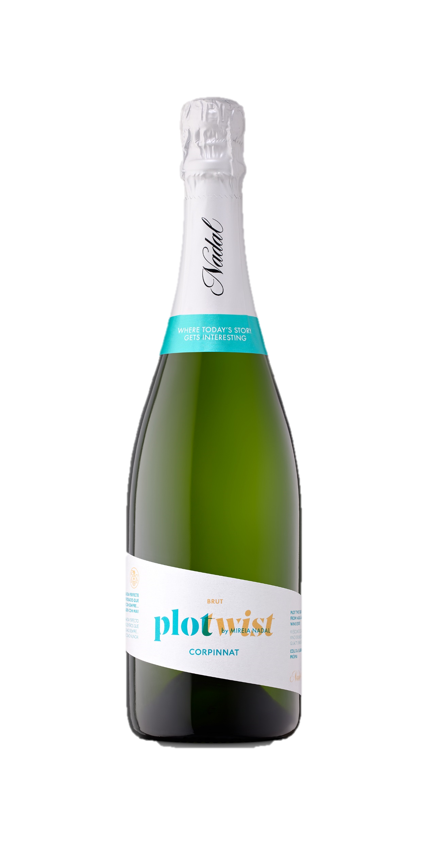
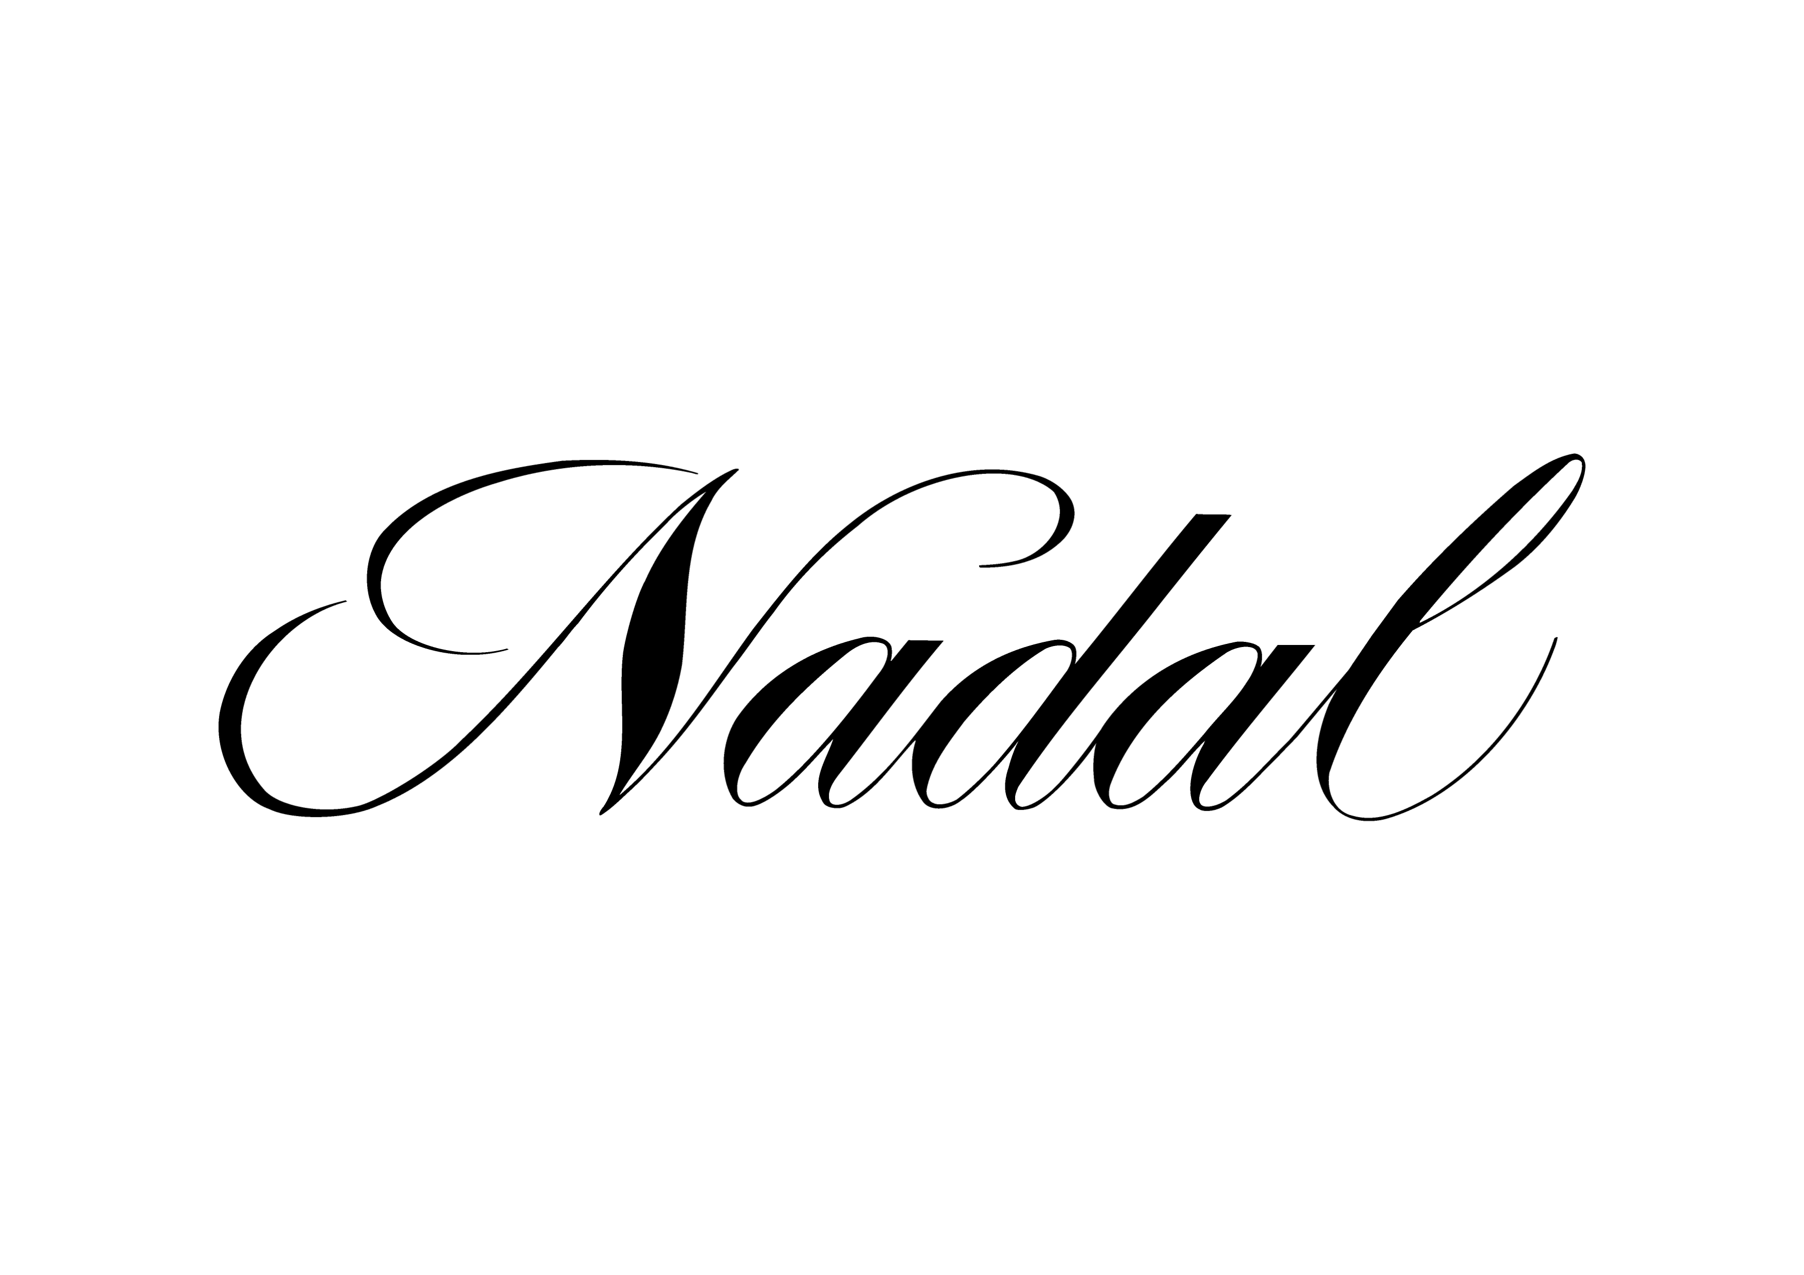
PLOT TWIST BRUT
SUGGESTIVE
The expression of modernity, but without losing the essence of the winery. For those meetings filled with good vibes and confessions, always full of the most unexpected plot twists
Made with traditional varieties refined with a special expedition liquor from Malvasia de Sitges. This brut with 48 months of ageing, is fresh, creamy and has a very tinny but crunchy bubble.
Style of wine:
CORPINNAT - Brut Reserva Multi Vintage
Appearance:
Pale yellow colour. Very tiny bubble.
Nose:
Fruity aromas , especially of white fruits.
Palate:
Fresh, creamy and persistent.
Storage conditions:
It is recommended to keep the sparkling wine inside the box in an upright position, at a temperature of 10-20ºC, avoiding direct sunlight.
Premium Sparkling Wine
CORPINNAT
Grape varieties:
44% Parellada
30% Xarel·lo
26% Macabeo
Estate-grown
Harvest:
Organic
Alcohol content:
12,5 % vol.
Residual sugar:
8,6 gr/l
Service temperature:
6-9ª
Case of 6 bottles of 75 cl: 10,3 kg (27 x 18,7 x 33 cm). EAN Code: 8424554570003

