Slide 1
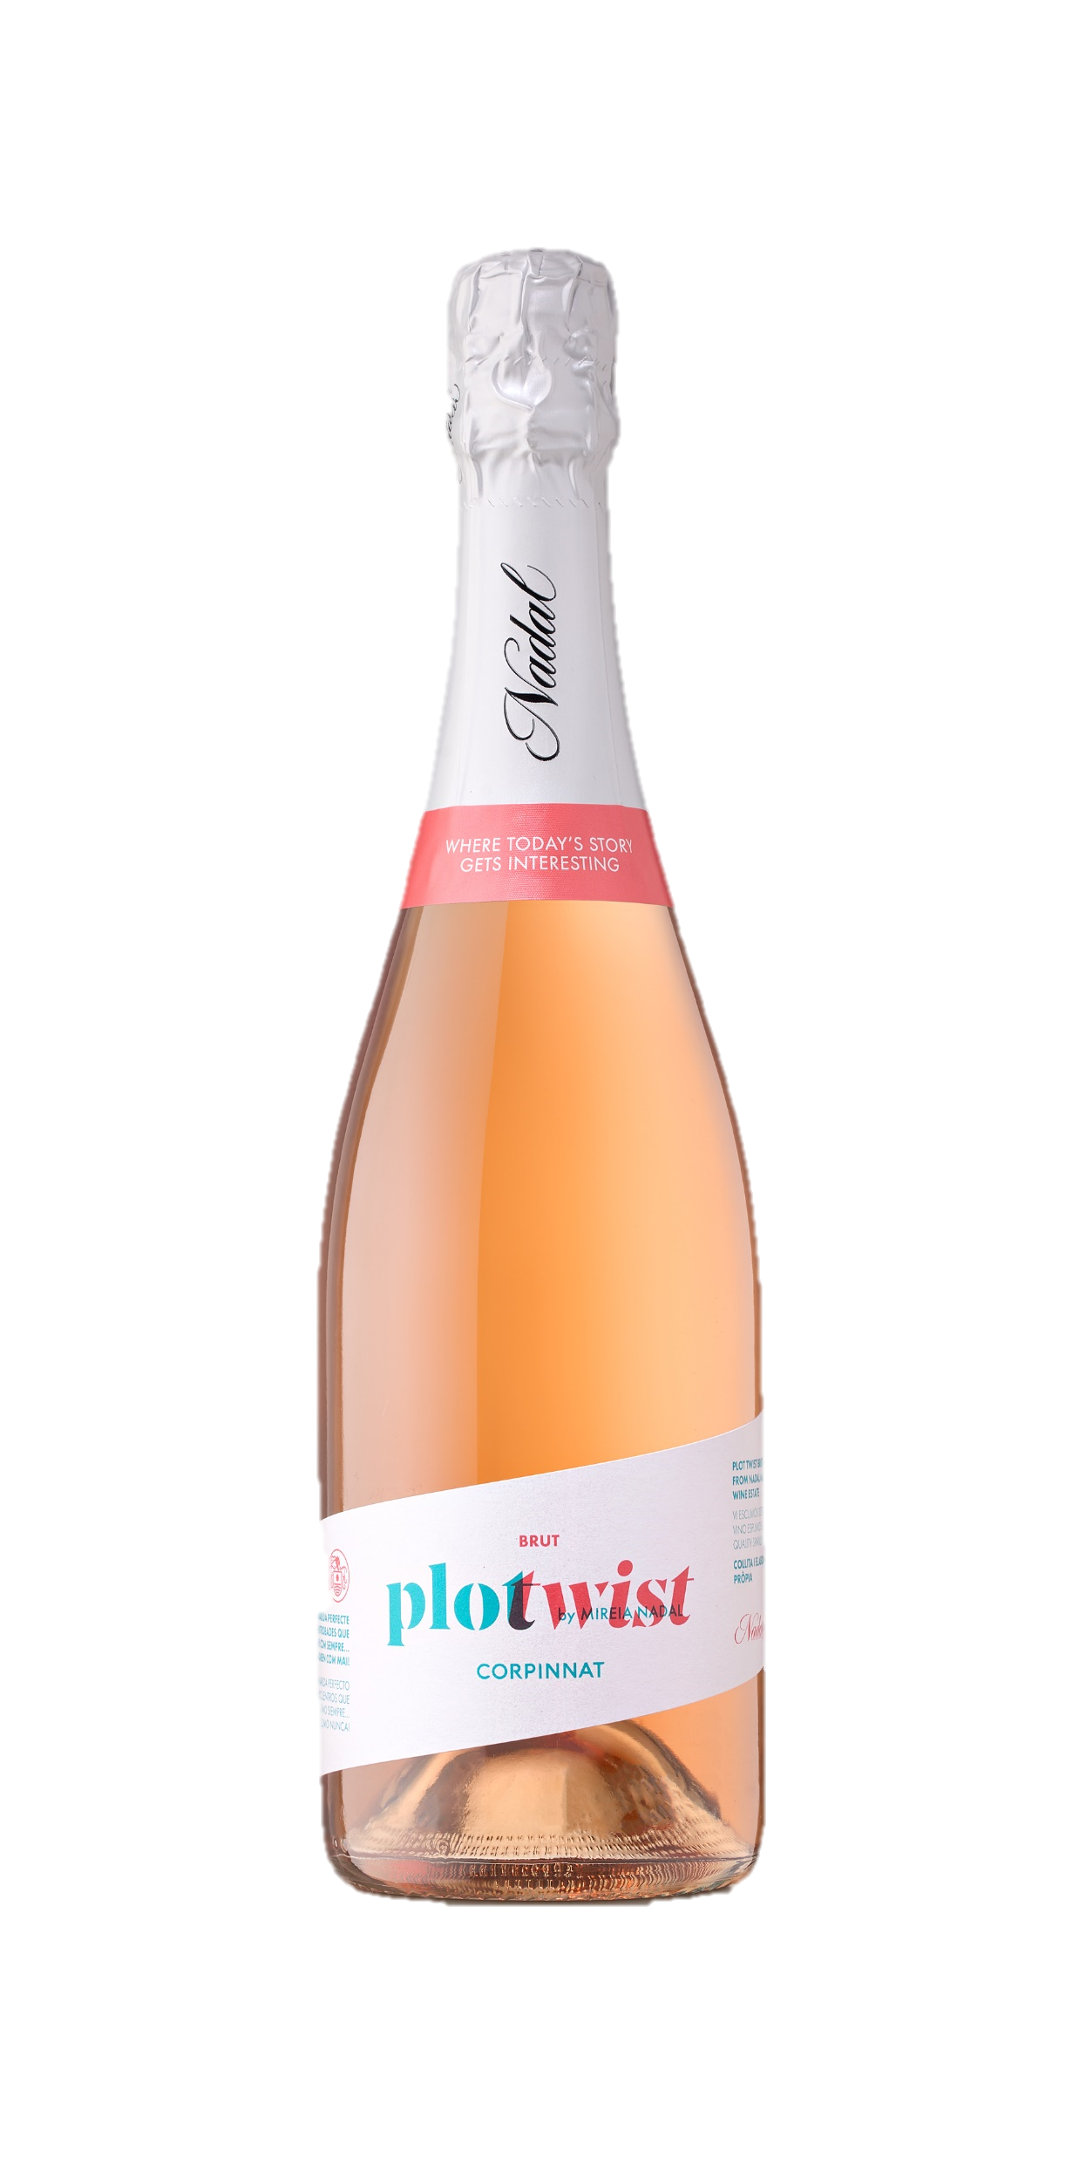

PLOT TWIST BRUT ROSE
SUGGESTIVE
The freshness of the first Macabeu harvested in the estate with the hints of red ripen fruit brought by a perfectly matured Pinot Noir, merge with the fragrance of Malvasia de Sitges. To enjoy this wine there is nothing else needed than a good glass and good company.
Start a get-together with friends with a glass of this corpinnat. The room will be filled with magic and amusement, and it will take the spotlight for sure.
Style of wine:
CORPINNAT - Brut Reserva Rosé Multi Vintage
Appearance:
Pale terracotta colour. Very tiny bubble.
Nose:
Red fruit hints with comfited bone fruits (peach, apricot)
Palate:
Crunchy beginning followed by a smooth and silky path.
Storage conditions:
It is recommended to keep the sparkling wine inside the box in an upright position, at a temperature of 10-20ºC, avoiding direct sunlight.
Premium Sparkling Wine
CORPINNAT
Grape varieties:
83% Macabeo
17% Pinot Noir
Estate-grown
Harvest:
Organic
Alcohol content:
13% vol.
Residual sugar:
9,7 gr/l
Service temperature:
6-9ª
Case of 6 bottles of 75 cl: 10,3 kg (27 x 18,7 x 33 cm). EAN Code: 8424554620002

